Slide 1

Coding Foundations: Your First Steps to Becoming a Programmer!
Behram Khan

Slide 2
Lecture Overview
In this first lecture we will cover the fundamental theoretical concepts that form the backbone of programming.
This session focuses solely on theory, providing a solid foundation for understanding computers and programming
Involving examples and interactive session to develop problem solving

Slide 3
Learning Objectives
By the end of this lecture, students will be able to:
Know about programming languages
How high level languages are translated to low level
Understand basic hello world program structure.

Slide 4
Recap
Interpreter -> translates one line at a time and executes it directly.
Compiler -> translates entire source code into object code in one go, then linker makes the object code into executable file.
Notes:
A timing signal is a clock signal used by the processor to synchronize various operations within the CPU, ensuring that instructions and data move through the system in a coordinated manner.
Control signals are commands sent by the control unit of the CPU to various parts of the system (like memory, ALU, registers, etc.) to execute certain tasks.
CIR (Current Instruction Register) is a special register in the CPU that holds the instruction currently being executed or processed.
When an instruction is fetched from memory, it is stored in the CIR before being decoded and executed.
Instruction Buffer Register (IBR) is a register used to temporarily store the next instruction fetched from memory, allowing the CPU to pre-fetch instructions.

Slide 5
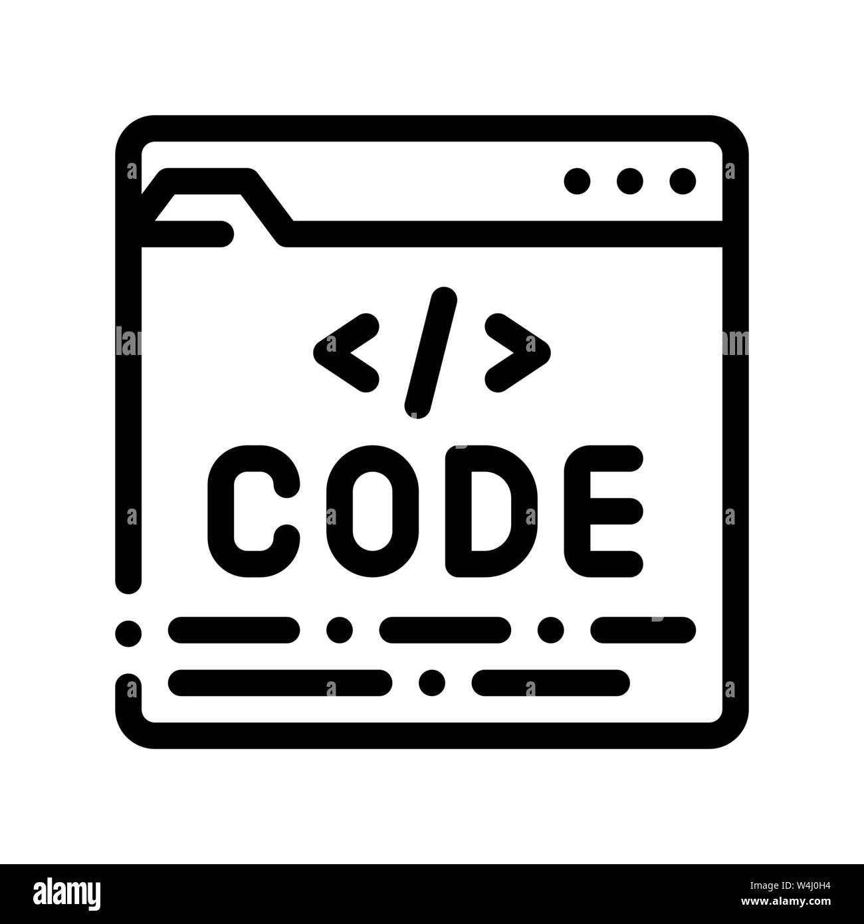
Compiler
Compiler
Object Code
Linker
Machine Code 1 and 0
HelloWorld.c
Executable File
Linker
HelloWorld.exe
Converts Object Code into Executable File
Notes:
gcc hello.c
gcc file.c -o name.exe
.\name.exe

Slide 6
Header file
Header file is a file which contains functions
f(x) = 2x + 1.
This function takes an input (x) and performs an operation on it (multiply by 2 and add 1) to produce an output.
In programming, a function is similar. It takes input values, performs a series of operations, and returns an output value.
<stdio.h> stands for Standard Input Output library
Stdio contains functions and instructions to display output and take input.
Notes:
Library vs header file
Header file only has definition of methods and its prototype
Library has its implementation, the actual code which runs and does the tasks.

Slide 7
Main Function
A Function which tells the compiler where our program starts from.
Every C program must have a main function/starting point of the program.
We write int before main to get error message.
Tells us if our program ran successfully or not.
We add () parenthesis after main to tell compiler this is a function.
We add { and } to tell compiler the starting and ending point of our program.
This is just the way functions are written.

Slide 8
Int a = 5 ??

Slide 9
Data Types
The type of data a variable can store and the operations that can be performed on that data.
Data types are essential because they help the computer understand how to understand and work with the data stored in memory.

Slide 10
Syntax for Declaring Data Types
Syntax: datatype variableName = value;
int a = 5;
int specifies the data type, a is the variable name, and 5 is the initial value assigned to it.

Slide 11
Common Data Types in C Programming
Integer (int)
Integers represent whole numbers, both positive and negative, without decimal points. -3 -2 -1 0 1 2 3
Holds 4 byte of data in memory
Declared with the int keyword
Int x;
Notes:
STR: Store a value to memory.
ADD: Add two values.
SUB: Subtract one value from another.
MOV: Move data from one location to another.

Slide 12
Common Data Types in C Programming
Floating-Point (float)
Represents numbers that include decimal points or fractions. 1.99, -1.4, 3.14
Holds 4 byte of data in memory
Declared with float keyword
float result;
Notes:
STR: Store a value to memory.
ADD: Add two values.
SUB: Subtract one value from another.
MOV: Move data from one location to another.

Slide 13
Common Data Types in C Programming
Character (char)
Holds a single character, like a letter, number, or symbol.
Declared using char keyword
char letter = ‘A’;
Enclosed in single quotes, e.g., 'a'. Only one character is allowed in a single char variable
Holds 1 byte of memory
Notes:
STR: Store a value to memory.
ADD: Add two values.
SUB: Subtract one value from another.
MOV: Move data from one location to another.

Slide 14
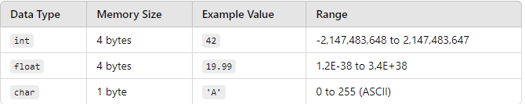
How Data Types Work in Memory
DataTypes.c
Notes:
STR: Store a value to memory.
ADD: Add two values.
SUB: Subtract one value from another.
MOV: Move data from one location to another.

Slide 15
Int a = 5 ??

Slide 16
Variable
A variable represents a memory location where data can be stored and accessed later.
When you declare a variable, you’re creating a labeled memory space that can hold a specific type of data.
Notes:
STR: Store a value to memory.
ADD: Add two values.
SUB: Subtract one value from another.
MOV: Move data from one location to another.

Slide 17
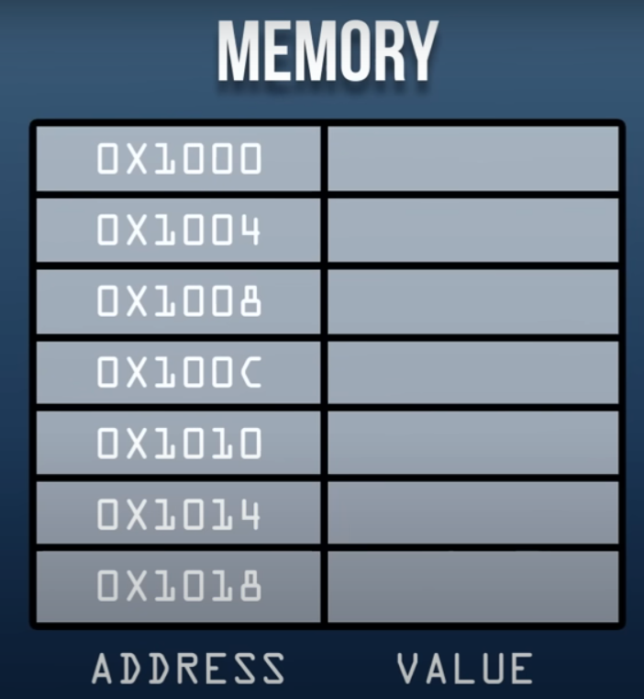








Visualizing
Int age;
Notes:
STR: Store a value to memory.
ADD: Add two values.
SUB: Subtract one value from another.
MOV: Move data from one location to another.

Slide 18
Variable Naming Rules
Variable names must begin with an alphabet (a-z, A-Z) or an underscore (_).
Names can include letters, digits (0-9), and underscores but cannot contain arithmetic symbols (e.g., +, -, *, /).
Variable names are case-sensitive, meaning myVariable and myvariable are treated as different variables.
Don’t use reserved keywords (e.g., int, float, char, if, else) as variable names.
Choose descriptive names that reflect the variable's purpose, improving readability.
Notes:
STR: Store a value to memory.
ADD: Add two values.
SUB: Subtract one value from another.
MOV: Move data from one location to another.

Slide 19
Key Properties
Fixed Name, Flexible Data:
The variable name remains the same throughout the program execution, but the data stored in that location can change.
One-Time Use of Name:
Each variable name is unique; once defined, you cannot assign the same name to another variable in the same scope.
IntNames.C File
Notes:
STR: Store a value to memory.
ADD: Add two values.
SUB: Subtract one value from another.
MOV: Move data from one location to another.

Slide 20
Int a = 5 ??

Slide 21
Variable Declaration and Initialization
Declaration: Defining a variable by assigning it a name and datatype.
int a;
Memory Representation: When declared, a memory location is assigned to it.
This memory location may hold garbage/random/default values until it is initialized.
Notes:
STR: Store a value to memory.
ADD: Add two values.
SUB: Subtract one value from another.
MOV: Move data from one location to another.

Slide 22
Visualizing
Int age;
Notes:
STR: Store a value to memory.
ADD: Add two values.
SUB: Subtract one value from another.
MOV: Move data from one location to another.

Slide 23
Variable Declaration and Initialization
Initialization: Assigning a value to a variable at the time of declaration.
Example: int a = 5;
You can declare first and initialize later:
int a; // Declaration
a = 5; // Initialization
Notes:
STR: Store a value to memory.
ADD: Add two values.
SUB: Subtract one value from another.
MOV: Move data from one location to another.

Slide 24








Visualizing
Int age;
Garbage Value
Notes:
STR: Store a value to memory.
ADD: Add two values.
SUB: Subtract one value from another.
MOV: Move data from one location to another.

Slide 25
Visualizing
Int age;
age = 5;
initializeVsDeclare File
Variable benefit : Reuse, one location change.
5
Notes:
STR: Store a value to memory.
ADD: Add two values.
SUB: Subtract one value from another.
MOV: Move data from one location to another.

Slide 26
Sizeof()
Function which tells us how much space in memory a variable occupies.
Syntax : sizeof(variableName);
Sizeof.c File
Notes:
STR: Store a value to memory.
ADD: Add two values.
SUB: Subtract one value from another.
MOV: Move data from one location to another.

Slide 27
Assignment operator
An assignment operator is used to assign a value to a variable.
It utilizes the assignment operator =
The process involves evaluating the expression on the right side of the operator and then assigning the resulting value to the variable on the left.
variable = expression or value;
Notes:
STR: Store a value to memory.
ADD: Add two values.
SUB: Subtract one value from another.
MOV: Move data from one location to another.

Slide 28
Assignment operator
Variable on the Left: The variable to which the value will be assigned is placed on the left side of the assignment operator.
Expression on the Right: The expression can be a constant value, another variable, or a combination of operands and arithmetic operations.
Int x =5;
the data types of the variable and the expression must be same.
This is important as different datatypes have different sizes and different operations.
AssignemntOperator.c File
Notes:
STR: Store a value to memory.
ADD: Add two values.
SUB: Subtract one value from another.
MOV: Move data from one location to another.

Slide 29
Compound Assignment
Assigning multiple variables values same values at the same time.
CompoundAssignment.c File
Notes:
STR: Store a value to memory.
ADD: Add two values.
SUB: Subtract one value from another.
MOV: Move data from one location to another.

Slide 30
Now we know how data is stored in memory How to manipulate it?

Slide 31
Arithmetic Operators

Slide 32
Arithmetic Operators
Symbols that represent mathematical operations used to perform mathematical operations.
Used in arithmetic expressions to perform calculations.
Each operator works on two numeric values (operands) and returns a result.
Syntax: Operand Operators Operand
Operators are symbols that perform specific operations on values
Operands are the values on which the operator acts.
Notes:
STR: Store a value to memory.
ADD: Add two values.
SUB: Subtract one value from another.
MOV: Move data from one location to another.

Slide 33
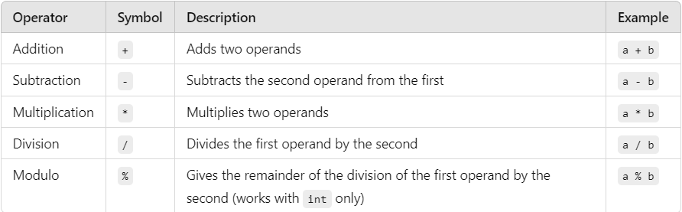
Arithmetic Operators
Notes:
STR: Store a value to memory.
ADD: Add two values.
SUB: Subtract one value from another.
MOV: Move data from one location to another.

Slide 34
Arithmetic Operators
The Modulo Operator (%)
Purpose: The modulo operator (%) provides the remainder after dividing the first operand by the second.
Example: 7 % 3 would return 1 because 7 / 3 has a remainder of 1.
Usage: Only works with integer values (int), as it calculates remainders.
AtithmeticOperators.c File
Notes:
STR: Store a value to memory.
ADD: Add two values.
SUB: Subtract one value from another.
MOV: Move data from one location to another.

Slide 35
Operator Precedence
The order of operations is important for evaluating expressions. The precedence of operators is as follows:
Parentheses (): Operations inside parentheses are evaluated first.
Multiplication *, Division /, and Modulo %: Evaluated from left to right.
Addition + and Subtraction -: Also evaluated from left to right.
Notes:
STR: Store a value to memory.
ADD: Add two values.
SUB: Subtract one value from another.
MOV: Move data from one location to another.

Slide 36
Operator Precedence
Example with Precedence:
int result = (5 + 3) * 2 - 4 / 2;
Step-by-step evaluation:
Parentheses: (5 + 3) = 8
Multiplication: 8 * 2 = 16
Division: 4 / 2 = 2
Subtraction: 16 - 2 = 14
ArithmeticExp.c File
Notes:
STR: Store a value to memory.
ADD: Add two values.
SUB: Subtract one value from another.
MOV: Move data from one location to another.

Slide 37
Now we know how data is stored in memory and how it is manipulated. How to send it to output device? How to take input from user?

Slide 38
Output in C
Output statements in programming are used to send data from the computer’s memory to an output device, like the screen (console), so users can see the results.
printf is a predefined output function in C used to display text and data on the console.
The console represents the computer display screen where results are shown.
Notes:
STR: Store a value to memory.
ADD: Add two values.
SUB: Subtract one value from another.
MOV: Move data from one location to another.

Slide 39
Output in C
Syntax of printf:
Basic Structure: printf("Data");
Notes:
STR: Store a value to memory.
ADD: Add two values.
SUB: Subtract one value from another.
MOV: Move data from one location to another.

Slide 40
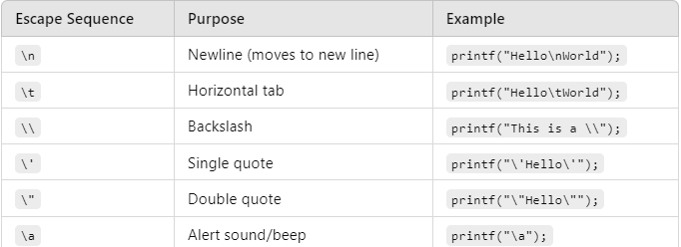
Escape Sequences
Escape sequences control the display of data on the output device. They are a combination of a backslash (\) and a code character.
EscapeSequence.c File
Notes:
STR: Store a value to memory.
ADD: Add two values.
SUB: Subtract one value from another.
MOV: Move data from one location to another.

Slide 41
Escape Sequences
Exercise 1:
Write a program to print a message "Hello, World!" 10 times, with each message on a new line.
Exercise 2:
Write a program to print numbers from 1 to 10, in a single line but having gaps.
EscapeSequenceTasks.c
Notes:
STR: Store a value to memory.
ADD: Add two values.
SUB: Subtract one value from another.
MOV: Move data from one location to another.

Slide 42
Format Specifiers in output
Syntax :printf("Data + format specifiers", variable1, variable2, ...);
Example: printf("%i", variable);
Explanation of Components:
Data: Text or placeholders (format specifiers) for values to be displayed.
Variables: Actual values that replace the placeholders.
Notes:
STR: Store a value to memory.
ADD: Add two values.
SUB: Subtract one value from another.
MOV: Move data from one location to another.

Slide 43
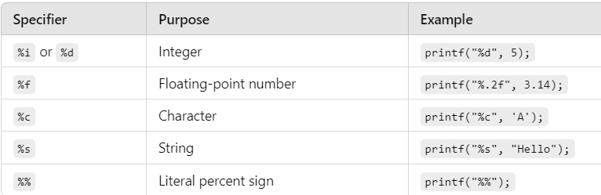
Format Specifiers
PrintFormatSpecifiers.c File
Notes:
STR: Store a value to memory.
ADD: Add two values.
SUB: Subtract one value from another.
MOV: Move data from one location to another.

Slide 44
Interpreter
An interpreter reads the source code line by line or statement by statement and executes it directly.
• There is no intermediate object code or executable file generated.
When the program runs
the interpreter processes the source code line by line
The interpreter reads one line of code
It translates that line into machine code and executes it immediately
Then it moves to the next line and repeats the process.
The interpreter must be present to execute the code, meaning that the user must have the interpreter installed to run the program.

Slide 45
Input Statements
Input statements are used to receive data from the user and assign it to variables.
When an input statement is executed, the program waits for the user to type a value and press Enter. The entered value is then assigned to the specified variable, and the program continues its execution.
Syntax : scanf("format specifier(s)", &variable1, &variable2, ...);
Format Specifiers for Input:
%d: Integer
%f: Floating-point number
%c: Character
Inputtypes.c File
Notes:
STR: Store a value to memory.
ADD: Add two values.
SUB: Subtract one value from another.
MOV: Move data from one location to another.

Slide 46


Calculate the area and circumference of a circle. Take the radius as input from the user.
1. Start
2. Declare Variables (radius(float) ,area (float),circumference (float) )
3. Input
Prompt the user to enter the radius of the circle.
Read the input value and store it in the radius variable.
4. Calculate
Calculate the area using the formula: area = 3.14 * radius * radius
Calculate the circumference using the formula : circumference=2 × 3.14 × radius=
5.Output:
Display the calculated area and circumference.
6.End
InputCircleRadius.C File
Notes:
a prompt refers to a message or instruction displayed to the user, indicating that the program is waiting for some input.

Slide 47


Get the age in years of a person and calculate the age in months
1. Start
2. Declare variables:
age_in_years (integer)
age_in_months (integer)
3. Prompt the user to enter their age in years.
4.Input:
Read the input age and store it in the age_in_years variable.
5. Calculate: Multiply age_in_years by 12 to get age_in_months.
6. Print the name of the person and their age in months to the console.
7. End
Notes:
a prompt refers to a message or instruction displayed to the user, indicating that the program is waiting for some input.

